Slide 1
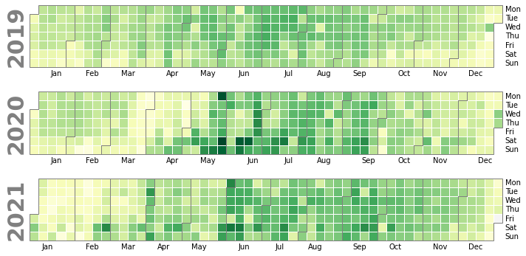
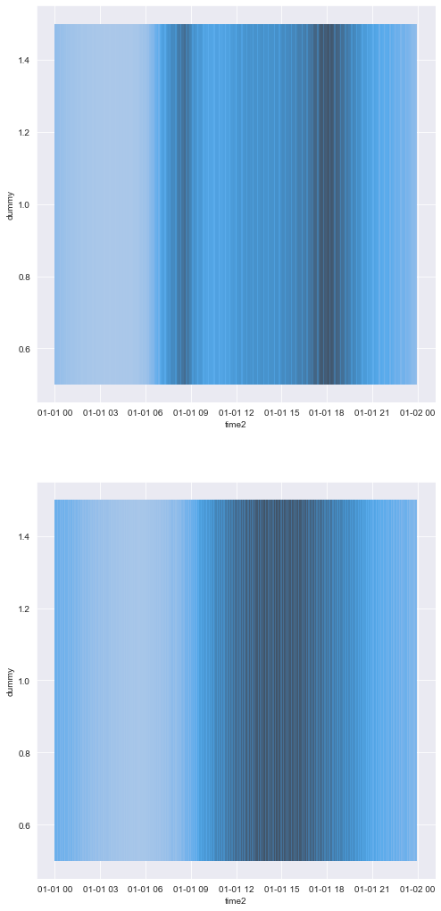
Santander Cycle Analysis
The TfL cycle hire dataset consists of data from 32 million journeys made by nearly 18,000 bikes between 800 docking stations from 2019 until 2021.
Patterns of usage
Usage increased during summer months
Usage declined sharply in March 2020 following the UK national coronavirus lockdown, before resuming in May.
Usage was bi-modal on weekdays, and unimodal on the weekend, indicating commuter use in the week and increased recreational use at the weekends
Fig 2.1: heatmap of journeys on weekdays
Fig 2.2: heatmap of journeys on weekends
Figure 1: Heatmap of Santander Cycle usage throughout analysis period

Slide 2
Our model – Graph Theory
To better understand this vast dataset, we have modelled this system using Graph Theory.
C = 2
Cycle hire usage can be modelled as a graph network, where docking stations are nodes, and each journey is an edge that connects two nodes.
The degree centrality of a node is a measure of the number of edges. Higher centrality scores indicate more heavily used docking stations.
We have additionally defined net centrality – a measure of the difference between the number of in edges and out edges
C = 3
C = 2
C = 1

Slide 3
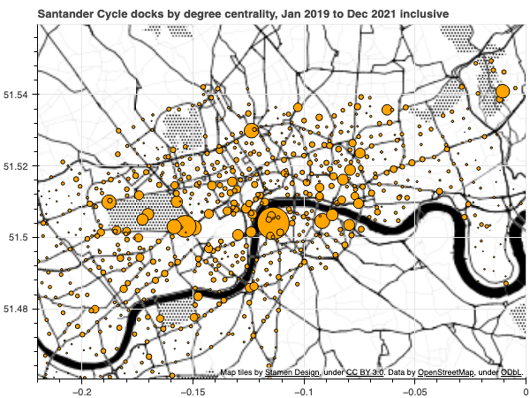
Recommendation 1: Prioritise installation of docks in high-use areas
Docks in Hyde Park, the Olympic Park, as well as transport hubs such as Waterloo, Kings Cross, Liverpool Street and London Bridge were in more frequent use during the analysis period. We recommend prioritising these sites for dock installation.
Dock station name | Average daily journeys
Waterloo Station , Waterloo | 637
Hyde Park Corner, Hyde Park | 440
Hop Exchange, The Borough | 307
Wellington Arch, Hyde Park | 301
Belgrove Street , King's Cross | 294
Albert Gate, Hyde Park | 289
Black Lion Gate, Kensington Gardens | 287
Aquatic Centre, Queen Elizabeth Olympic Park | 275
Duke Street Hill, London Bridge | 239
Triangle Car Park, Hyde Park | 234
Tooley Street, Bermondsey | 229
Park Lane , Hyde Park | 228
Serpentine Car Park, Hyde Park | 226
Storey's Gate, Westminster | 220
Wormwood Street, Liverpool Street | 219
Figure 3: Docking stations by degree centrality

Slide 4
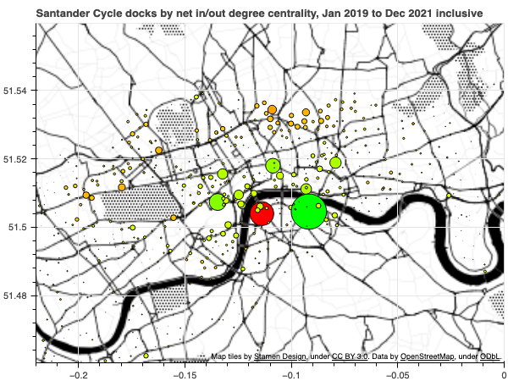
Recommendation 2: Redistribute bikes from net sinks to net sources
Certain docks had notably more bikes docked than undocked during the analysis period (sinks), or vice versa (sources).
To ensure balancing of the network, we recommend redistribution of bikes from sinks to sources through either price incentives or actively relocating bikes during quiet periods.
Docking station name | Daily surplus
Hop Exchange, The Borough | 45
St. James's Square, St. James's | 21
Holborn Circus, Holborn | 18
Brushfield Street, Liverpool Street | 14
Queen Street 2, Bank | 13
Soho Square , Soho | 13
Docking station name | Daily deficit
Waterloo Station, Waterloo | -30
Cloudesley Road, Angel | -11
Eagle Wharf Road, Hoxton | -9
Lancaster Gate , Bayswater | -9
Boston Place, Marylebone | -8
Notting Hill Gate Station, Notting Hill | -8
Figure 4: Docking stations by net centrality

